Slide 1
Opportunity for restructuring Discounting Strategy
Consulting & Co
12 June 2021

Slide 2
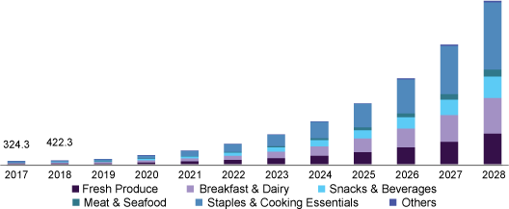
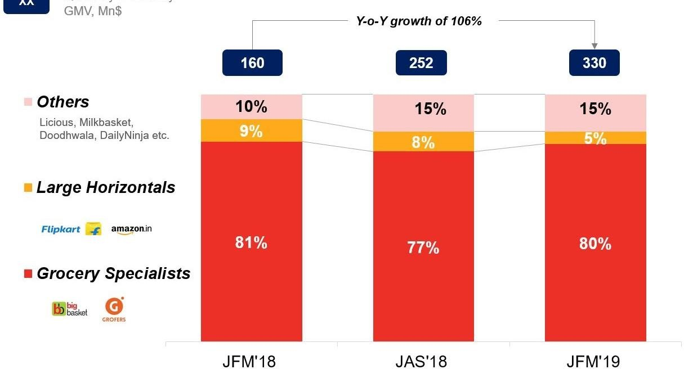
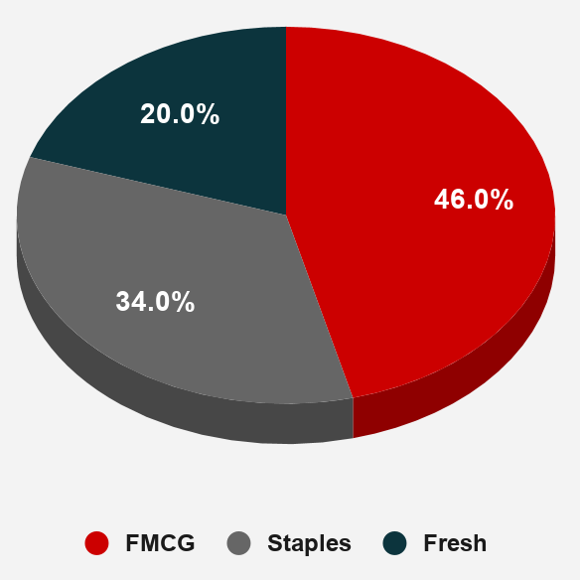
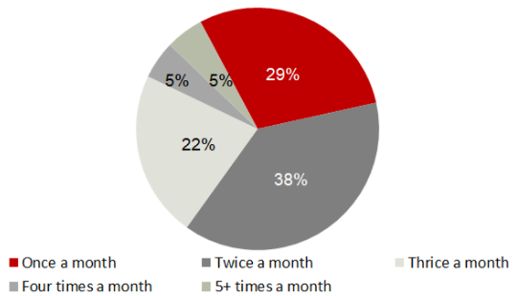
Our Understanding of the industry
•Indian e-grocery market is projected to grow by 10x in the next 5 - 7yrs.
Drivers of growth:
Successful early adopters and Consumer empowerment
Competitive pricing and change in customer attitude
Trusted information and tracked across the supply chain
No contact delivery and online payment
Omnichannel shopping experience.
Projection of e-grocery market by split of products
Current split of market share among major players
Current split of e-grocery orders
Consumer online grocery usage frequency

Slide 3
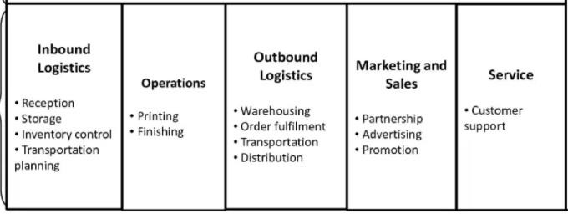
Our Understanding of e-mandi
Key features differentiating from competition:
Inventory led model
High quality products
Competitive prices
Quick delivery
Scale for profitable growth
Give shoppers options for getting their online orders.
Improve seamless shopping
Key Competitors:
BigBasket, Peppertap, Grofers, Zopnow, Postmates, Localbanya
6.9
1.2
Net Profit
6
1.1
4.9
0.9
12.2
Other Expenses
Costs
14.9
17.9
FY18
FY19 FY20
Trend of financials
Tea, 7% Biscuits, 4%
Salt, 8% Coffee, 14%
Fruit, 7%
Rice, 28%
Fruit Juice, 31%
Our understanding of the value chain of e-mandi
Revenue split of products – last 6 months

Slide 4
Observations from our team
We have identified that the Customer Acquisition & Retention costs Y-o-Y haven’t
been in line with the revenue growth and cost trends
Other expenses Salaries Utilities Marketing
Customer Acquisition & Retention Warehouse
Out-bound logistics In-bound logistics Supplier acquisition
17.21%
19.46%
20.11%
FY18
FY19
FY20

Slide 5
Data supporting our observation
Sales – quantities of products last 6 months
▪ Seasonal trends haven’t been
boosted
12000
▪ For example,
10000
▪ Fruit Juice surge in January
▪ Rice surge in December
Biscuits Coffee Fruit
Fruit Juice Rice
Salt Tea
8000
6000
4000
2000
▪ Also we see that there was no change in the strategy to move the inventory during the dip in February
0
Oct Nov Dec Jan Feb Mar

Slide 6

Opportunity to boost topline through discounting realignment
Number of users - average order size in last 6 months
800
600
400
200
0
Revenues can be driven by the three levers
Higher order size
Less than 300 300-350 350-400 More than 400
Number of users - number of orders in last 6 months
600
Higher ordering frequency
400
200
0
Less than 25
25-30 30-35
Sales - volumes
35-40
More than 40
28300
28200
28100
28000
Higher % of higher margin products
27900
27800
27700
27600
27500
Bad Day
Mary
Descafe
Orange
Subtropic
Apple squash
Subtropic Orange squash
Golden grain 1kg
Golden grain 2kg
Arabian Delight
Mumtaz Mahal
This slide can be split into 1 landing slide
+ 3 individual slides about each lever
Biscuits
Coffee Fruit
Fruit Juice
Rice
Salt Tea

Slide 7
Cart size and frequent ordering
Number of users - average order size in last 6 months
▪ Average order size and order frequency of ordering are inversely proportional
700
600
500
400
300
200
100
0
▪ Order sizes can be increased using cart size based discounting
Less than 300 300-350 350-400 More than 400
Number of users - number of orders in last 6 months
▪ Frequent ordering can be encouraged by subscription model discounting
600
500
400
300
▪ We can iterate between the two and identify most suitable scenarios to boost margins
200
100
0
Less than 25
25-30
30-35
35-40
More than 40

Slide 8
Increasing share of higher margin products
Row Labels | Quantity sold | Margin %
Biscuits | 55787
Bad Day | 28045 | 5%
Mary | 27742 | 3%
Coffee | 27833
Descafe | 27833 | 7%
Fruit | 27877
Orange | 27877 | 5%
Fruit Juice | 56151
Subtropic Apple squash | 28003 | 7%
Subtropic Orange squash | 28148 | 7%
Rice | 55679
Golden grain 1kg | 27820 | 6%
Golden grain 2kg | 27859 | 8%
Salt | 28187
Arabian Delight | 28187 | 6%
Tea | 27910
Mumtaz Mahal | 27910 | 5%
Grand Total | 279424
Sales - volumes
28500
28000
27500
27000
26500
26000
25500
25000
Bad Day
Mary
Descafe
Orange
Subtropic Apple squash
Subtropic Orange squash
Golden grain 1kg
Golden grain 2kg
Arabian Delight
Mumtaz Mahal
Biscuits
Coffee
Fruit
Fruit Juice
Rice
Salt
Tea
▪ Orange squash is a competitor to oranges whereas it is a substitute apple squash
Rice offered in two different packaging has different margin %
Mary and Bad Day are direct competitors with significantly different margin %

Slide 9
Approach we shall follow
Phase
Key Steps
Enablers
Ideate
Analyzing more historic data from other functions
Alignment of functions and personnel of all dependent functions
•Brainstorming
frameworks
•Data analytics tools
Ideate
Test designs, setting up of measurement system
Launch and monitoring of test scenarios on various customer groups
Test
•Test design
frameworks
Analyzing responses through data and identifying improvement pathways
•Decision making
frameworks
•Financial modelling
Iterate
Iterate
Transfer of knowledge to company personnel for sustanence

